Slide 1

Vel Tech Rangarajan Dr. Sagunthala R&D Institute of Science and Technology
School of Computing
Department of Computer Science and Engineering
PROJECT – 1 : ReactJS Web Application Development
TICKET BOOKING OF AN INTERNAL DEPARTMENT EVENT
Date: 23-03-2026
React JS Based Web Application for Internal Department Event Ticket Booking
SDG 9 – Industry, Innovation & Infrastructure
Courses Handling Faculty:
Dr.S.Hemamalini
Associate Professor(Senior-Grade)
Presented By:
B.RAMA KRISHNA– VTU25818 – 23UECS0074

Slide 2
INTRODUCTION
The React JS Based Ticket Booking Web Application is a React JS based web application that allows students and faculty to view event details and book tickets online for internal department events such as technical fests and seminars.
The application is built using Functional Components, JSX, and the useState hook for state management, following modern React development practices.
It features an Event Details Module that displays event name, department, date, time, venue, ticket price, and available tickets.
A Ticket Booking Module allows users to enter their name, email, department, and number of tickets, with real-time validation and booking confirmation.
This system is developed using PHP and MySQL on XAMPP server, ensuring reliable data storage and efficient backend processing.
1
2
3
4
5
6
7
8
9

Slide 3
PROBLEM STATEMENT
Department events like technical fests and seminars lack a dedicated digital platform for ticket booking and attendee management.
Students and faculty have no centralized system to view event details such as venue, timing, ticket price, and availability in one place.
Manual ticket booking processes lead to overbooking, data errors, and difficulty in tracking the number of available tickets.
Input validation is often absent in manual systems, allowing invalid email formats, zero or negative ticket counts, and empty submissions.
There is no mechanism to display a real-time updated ticket count or provide booking confirmation to the user after registration.
Absence of a structured web-based system wastes administrative time and leads to poor event communication.
Limited accessibility to skill-based opportunities restricts personal and professional growth.
Without proper error handling, users submit incomplete or invalid booking data, causing confusion and duplicate registrations.
1
2
3
4
5
6
7
8
9

Slide 4
OBJECTIVE(S)
To design and develop a React JS based web application for ticket booking of an internal department event.
To build an Event Details Module displaying event name, department, date, time, venue, ticket price, and available tickets.
To implement a Ticket Booking Module: collects user name, email ID, department, and number of tickets with full input validation.
To apply React concepts: functional components, JSX, useState hook, event handling, and conditional rendering.
To prevent overbooking by validating that requested tickets do not exceed the available ticket count.
To display a booking confirmation with user name, event name, tickets booked, and total amount after successful booking.
To handle invalid inputs gracefully and show user-friendly error messages for all validation failures.
To integrate an H2 in-memory database as backend with proper component structure and code readability.
1
2
3
4
5
6
7
8
9

Slide 5
PROPOSED SYSTEM
1
The proposed system is a web-based Skill Marketplace application developed using PHP and MySQL.
It allows users to register, login, and manage their profiles securely.
The system enables users to explore a variety of skill-based courses in one platform.
Users can enroll in courses and access them through a personalized dashboard.
After a successful booking, the system updates the available ticket count in real time and displays a booking summary with total amount.
The system maintains enrollment records for tracking user activity and course participation.
2
3
4
5
6
7
8
9

Slide 6
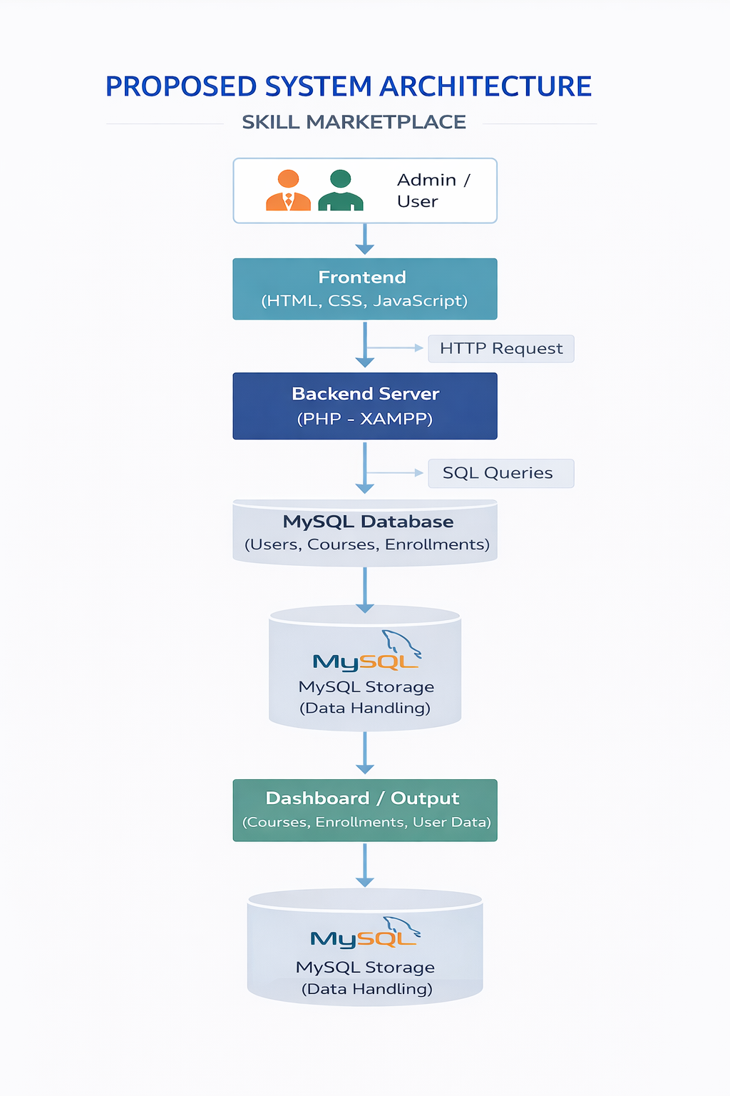
PROPOSED SYSTEM ARCHITECTURE
1
2
3
4
5
6
7
8
9

Slide 7
PROPOSED SYSTEM ARCHITECTURE
➤ Input
Users enter registration details, login credentials, and select courses through web forms. They can browse courses and perform enrollment actions.
➤ Processing
PHP processes user requests, handles authentication, manages course enrollment, and executes necessary operations through server-side logic.
➤ Database
MySQL database stores user details, course information, and enrollment records using relational tables.
➤ Output
The system displays updated available ticket count, booking confirmation summary (user name, event name, tickets booked, total amount) in the browser after each successful booking.
1
2
3
4
5
6
7
8
9

Slide 8
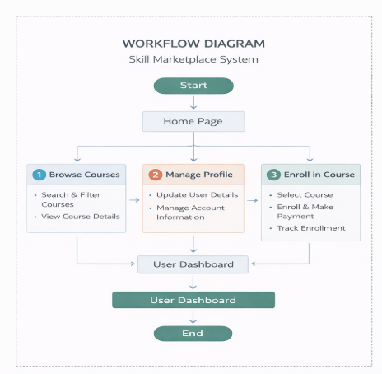
WORKFLOW
1
2
3
4
5
6
7
8
9

Slide 9
TECHNOLOGIES USED
1
2
➤ Frontend: React JS (Functional Components, JSX, useState Hook)
➤ Backend: Java (Spring Boot)
➤ Database: H2 In-Memory Database
➤ Server: Embedded H2 / Spring Boot Server
➤ Tools: VS Code, H2 Console
➤ Hardware/Software: Windows OS, Node.js / Spring Boot
3
4
5
6
7
8
9

Slide 10
MODULE DESCRIPTION
1
Module 1: Event Details Module
Displays event name, department name, event date and time, venue, ticket price, and the number of available tickets using a dedicated React component.
Module 2: Ticket Booking Module
Collects user inputs — name, email ID, department, and number of tickets — validates all fields, and processes the booking upon successful validation.
Module 3: Validation & Error Handling Module
Ensures all fields are mandatory, email ID is in valid format, and ticket count is a positive number not exceeding available tickets. Displays appropriate error messages.
Module 4: Booking Confirmation & Summary Module
Displays booking confirmation with user name, event name, number of tickets booked, and total amount. Updates available ticket count after each successful booking.
2
3
4
5
6
7
8
9

Slide 11
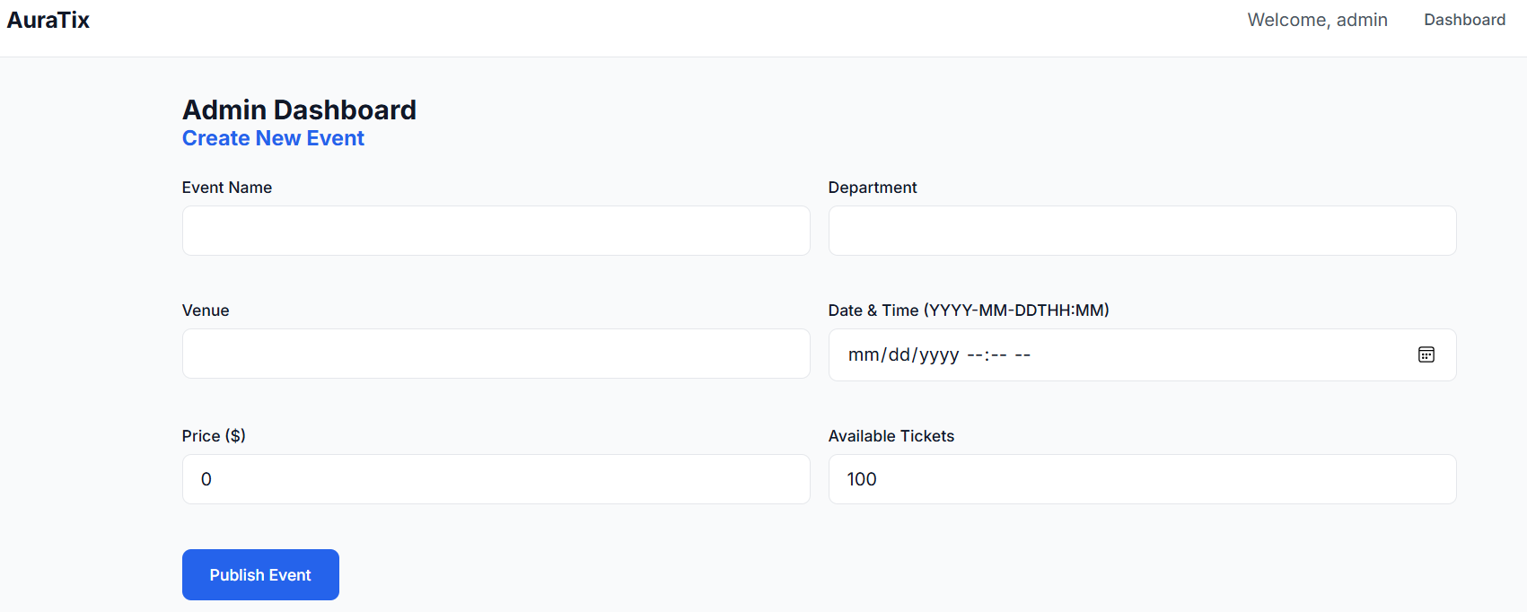
IMPLEMENTATION SCREENSHOTS
1
➤ The Home Page serves as the main navigation interface of the Skill Marketplace system.
➤ It provides a clean UI with CSS styling, displaying all event information and the booking form in a single-page React application.
➤ The Dashboard allows users to view enrolled courses and track their learning activity.
➤ The interface is styled with simple CSS for better UI and is designed to be user-friendly and responsive in the browser.
2
3
4
5
6
7
8
9

Slide 12
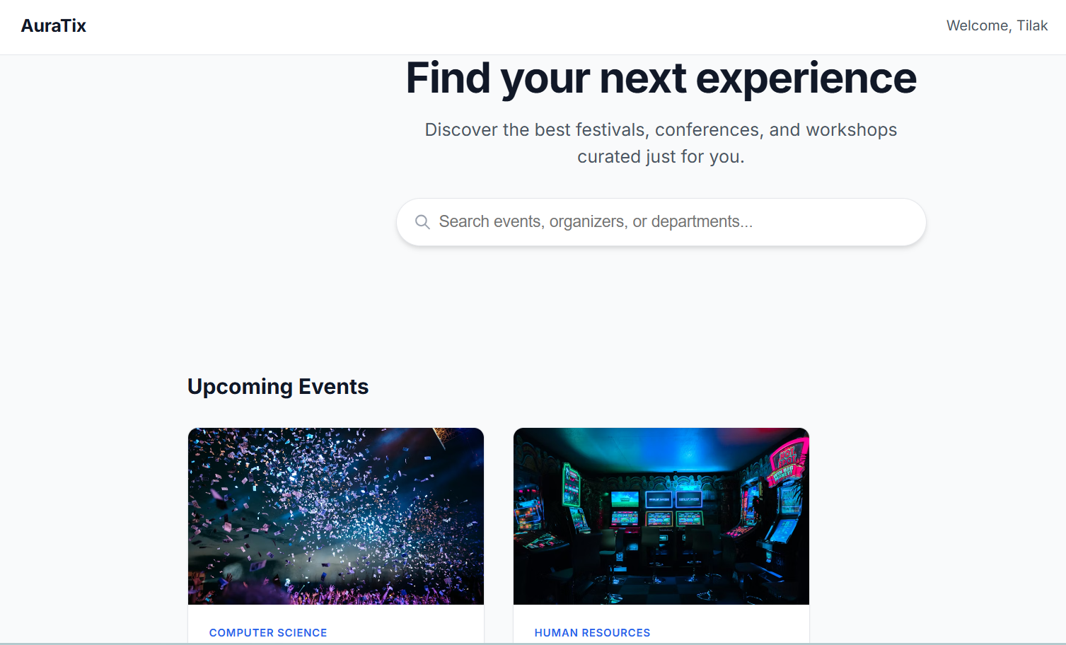
IMPLEMENTATION SCREENSHOTS
1
➤ The Booking Confirmation section renders conditionally after a successful ticket booking using React conditional rendering.
➤ These values are dynamically derived from the React state (useState) and rendered only after passing all validation checks.
➤ The available ticket count is updated in real time after each successful booking, preventing overbooking through state-managed validation.
➤ The Reset button clears all form fields and resets the booking form state, allowing users to make a new booking.
➤ All state transitions (form input, validation errors, confirmation display) are managed using the useState hook with no page reloads.
2
3
4
5
6
7
8(A)
9

Slide 13
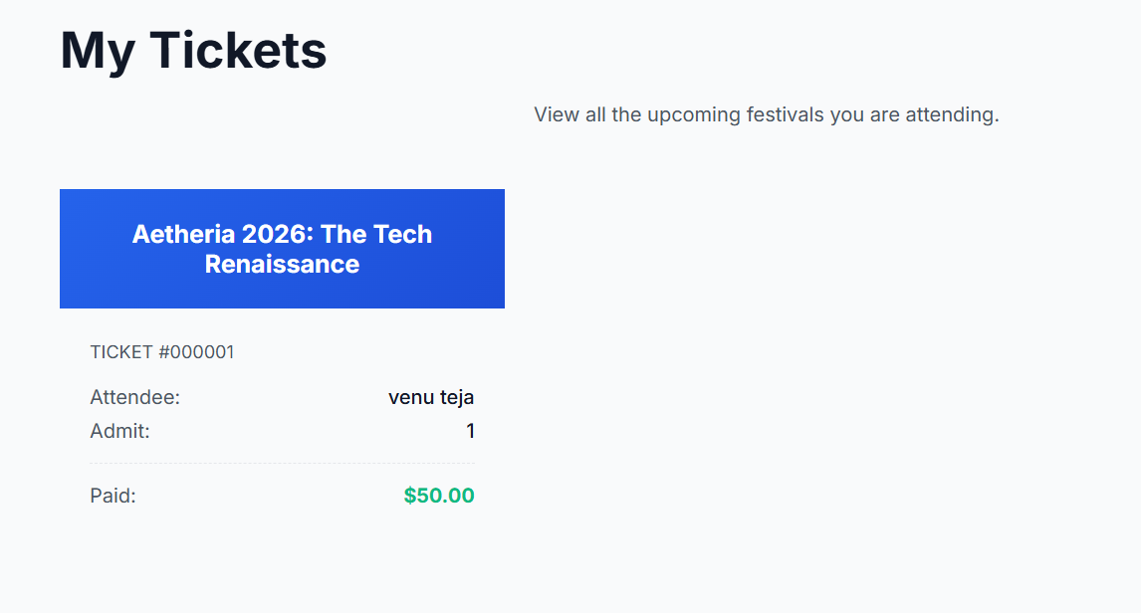
IMPLEMENTATION SCREENSHOTS
1
Validation & Error Handling Module:
➤ The Validation Module ensures all input fields are mandatory before allowing the booking to proceed.
➤ If any field is left empty, an error message "This field is required" is displayed below the respective input.
➤ The email ID is validated using a regular expression to ensure it follows a valid format (e.g., user@domain.com).
➤ The number of tickets is checked to ensure it is a positive integer and does not exceed the available ticket count.
➤ All error messages are displayed conditionally using React conditional rendering without reloading the page.
➤ If all validations pass, the form is accepted and the booking confirmation is displayed; otherwise, errors are shown inline.
➤ This module ensures graceful error handling and provides a smooth, user-friendly booking experience throughout the application.
2
3
4
5
6
7
8(C)
9

Slide 14
ADVANTAGES & LIMITATIONS
1
Advantages
Provides a fully functional React JS web app for department event ticket booking
Uses modern React concepts: functional components, useState, JSX, and conditional rendering
Real-time ticket availability update prevents overbooking instantly
Comprehensive input validation with user-friendly inline error messages
Booking summary displays total amount, event name, and user details clearly
Clean component separation (EventDetails, BookingForm) ensures code readability
Limitations
Designed for internal department use; not scalable for large multi-event systems
No QR-based ticket scanning or real online payment gateway integration
H2 is an in-memory database; data is lost when the application restarts
No admin panel to dynamically create or modify events from the UI
Authentication and user login are not implemented in this milestone
2
3
4
5
6
7
8
9

Slide 15
Thank you

